Slide 1


Exposure Java 2013
APCS Edition
Chapter 21 Slides
Advanced Graphics
PowerPoint Presentation
created by:
Mr. John L. M. Schram
and Mr. Leon Schram
Authors of Exposure Java

Slide 2
Section 21.1
Introduction

Slide 3
AP Exam Alert
This is an optional chapter in the
AP Computer Science curriculum.
The graphics concepts in this chapter and future input/output chapters will not be tested on the AP Computer Science Examination.

Slide 4
Section 21.2
Drawing
Individual Pixels

Slide 5
// Java2101.java
// This program draws a series of pixels with the
// <drawLine> method. This is accomplished by
// using the same start and end coordinates.
import java.awt.*;
public class Java2101 extends java.applet.Applet
{
public void paint(Graphics g)
{
for (int x=100, y=100; x <= 500; x+=5, y+=5)
g.drawLine(x,y,x,y);
}
}

Slide 6
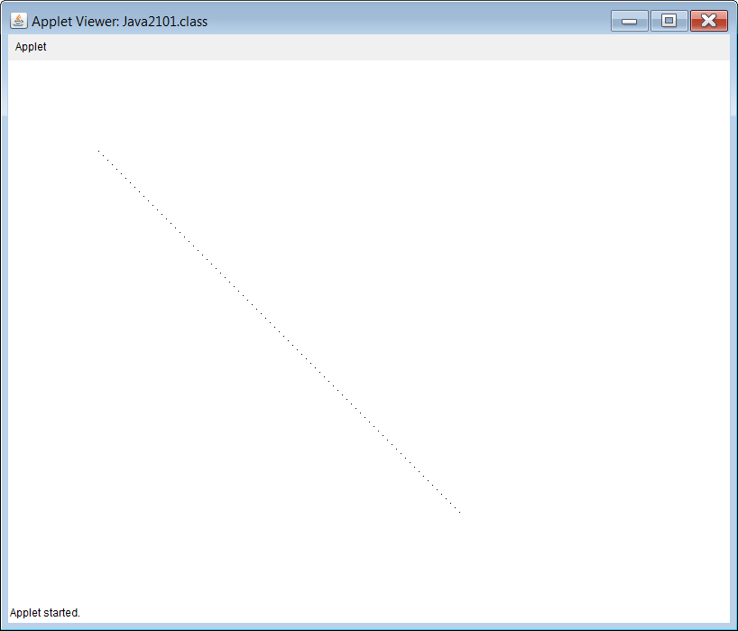

Slide 7
// Java2102.java
// This program draws a series of pixels with the
// <fillRect> method. This approach may be better
// if large pixels are necessary.
import java.awt.*;
public class Java2102 extends java.applet.Applet
{
public void paint(Graphics g)
{
for (int x=100, y=100; x <= 500; x+=5, y+=5)
g.fillRect(x,y,2,2);
}
}

Slide 8
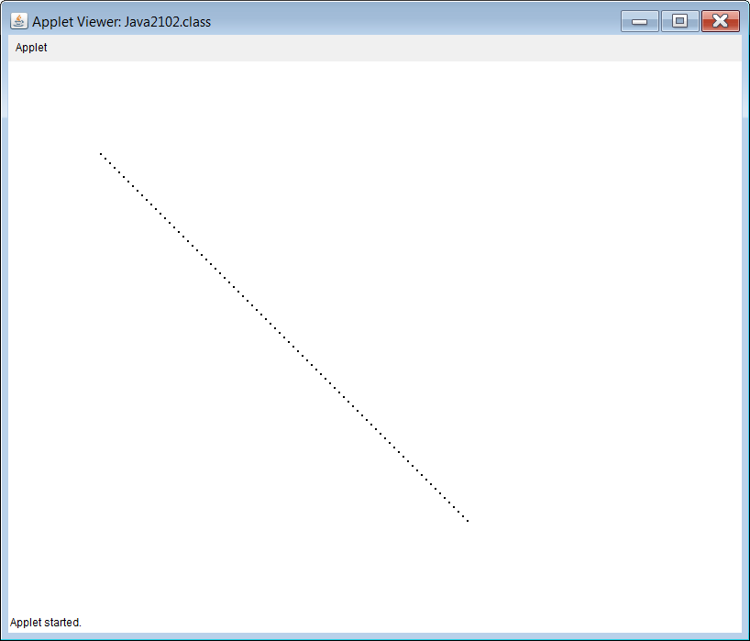

Slide 9
Section 21.3
Using the
Font class

Slide 10
// Java2103.java
// This program introduces the <setFont(new Font(Type,Style,Size))> method.
// Type is either "Courier","TimesRoman", "Arial", or any other available font.
// Style is either BOLD, ITALIC or PLAIN. Size is the point value of the font.
import java.awt.*;
public class Java2103 extends java.applet.Applet
{
public void paint(Graphics g)
{
g.drawString("Default Appearance with drawString",20,20);
g.setFont(new Font("Courier",Font.PLAIN,20));
g.drawString("Courier 20-point plain font",20,60);
g.setFont(new Font("Courier",Font.BOLD,20));
g.drawString("Courier 20-point bold font",20,100);
g.setFont(new Font("TimesRoman",Font.PLAIN,36));
g.drawString("Times Roman 36-point plain font",20,180);
g.setFont(new Font("TimesRoman",Font.ITALIC,36));
g.drawString("Times Roman 36-point italic font",20,260);
g.setFont(new Font("Arial",Font.PLAIN,48));
g.drawString("Arial 48-point plain font",20,360);
g.setFont(new Font("Arial", Font.BOLD + Font.ITALIC, 48));
g.drawString("Arial 48-point bold and italic font",20,460);
g.setFont(new Font("Qwerty",Font.PLAIN,24));
g.drawString("Arial 24-point plain font substituted for non-existent Qwerty font",20,520);
}
}
Output shown
on the next slide

Slide 11
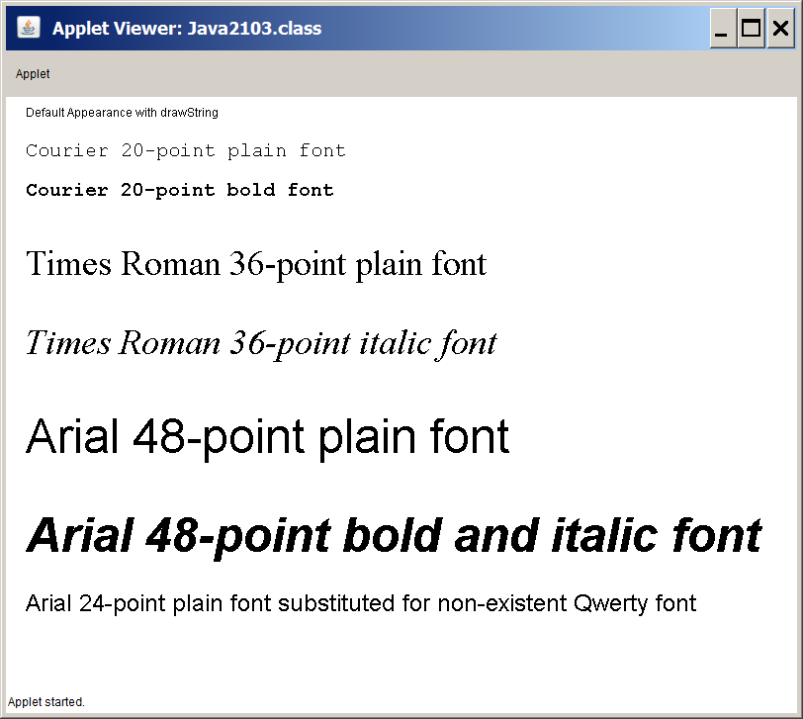

Slide 12
The setFont Method
g.setFont(new Font("Courier",Font.BOLD,20));
alters the default font to Courier, Bold and size 20.
An object of the Font class is used to change the font.

Slide 13
Section 21.4
Mathematics
and Polygons

Slide 14
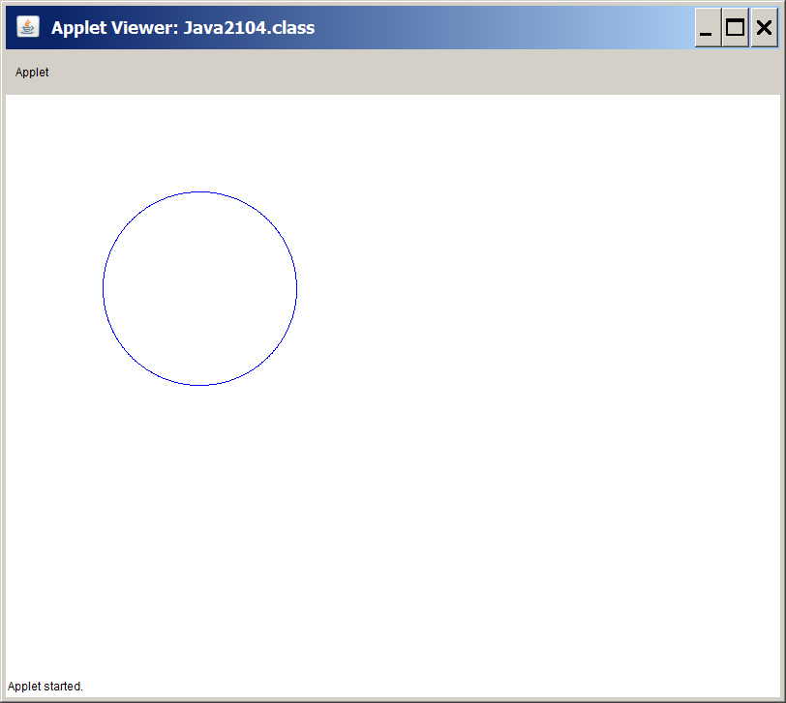
// Java2104.java
// This program draws a circle using the <cos> and <sin> methods of the <Math>
// class. It is simpler to use the <drawOval> method. This program helps to
// explain the next program.
import java.awt.*;
public class Java2104 extends java.applet.Applet
{
public void paint(Graphics g)
{
int x,y;
int radius = 100;
int centerX = 200;
int centerY = 200;
g.setColor(Color.blue);
for (double radian = 0; radian <= 2 * Math.PI; radian += 0.01)
{
x = (int) Math.round(Math.cos(radian) * radius) + centerX;
y = (int) Math.round(Math.sin(radian) * radius) + centerY;
g.drawLine(x,y,x,y);
}
}
}

Slide 15
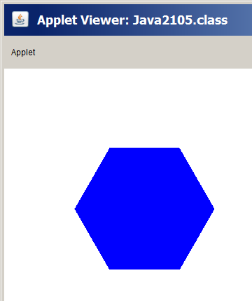
// Java2105.java
// This program draws a regular hexagon using the <cos> & <sin> methods of the <Math> class.
import java.awt.*;
public class Java2105 extends java.applet.Applet
{
public void paint(Graphics g)
{
int radius = 100; int centerX = 200; int centerY = 200;
double twoPI = 2 * Math.PI;
g.setColor(Color.blue);
int x1 = (int) Math.round(Math.cos(twoPI * 1/6) * radius) + centerX;
int y1 = (int) Math.round(Math.sin(twoPI * 1/6) * radius) + centerY;
int x2 = (int) Math.round(Math.cos(twoPI * 2/6) * radius) + centerX;
int y2 = (int) Math.round(Math.sin(twoPI * 2/6) * radius) + centerY;
int x3 = (int) Math.round(Math.cos(twoPI * 3/6) * radius) + centerX;
int y3 = (int) Math.round(Math.sin(twoPI * 3/6) * radius) + centerY;
int x4 = (int) Math.round(Math.cos(twoPI * 4/6) * radius) + centerX;
int y4 = (int) Math.round(Math.sin(twoPI * 4/6) * radius) + centerY;
int x5 = (int) Math.round(Math.cos(twoPI * 5/6) * radius) + centerX;
int y5 = (int) Math.round(Math.sin(twoPI * 5/6) * radius) + centerY;
int x6 = (int) Math.round(Math.cos(twoPI) * radius) + centerX;
int y6 = (int) Math.round(Math.sin(twoPI) * radius) + centerY;
Polygon hex = new Polygon();
hex.addPoint(x1,y1); hex.addPoint(x2,y2); hex.addPoint(x3,y3);
hex.addPoint(x4,y4); hex.addPoint(x5,y5); hex.addPoint(x6,y6);
g.fillPolygon(hex);
}
}

Slide 16
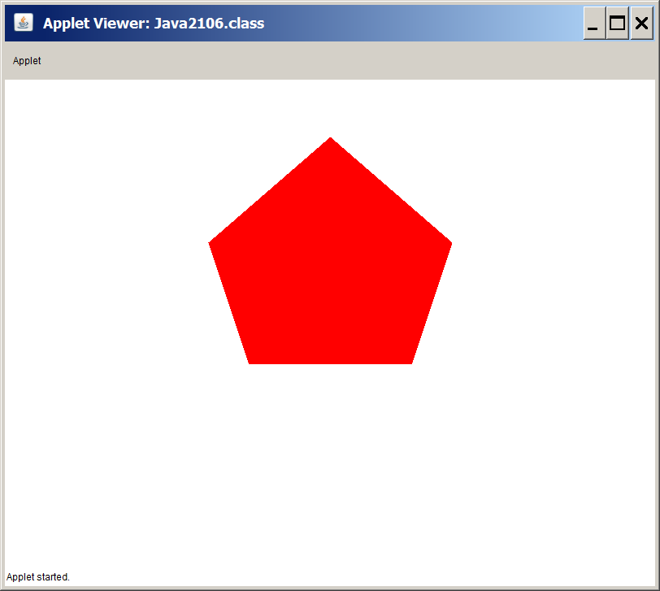
// Java2106.java
// This program draws a pentagon
// with the <fillPolygon> method.
// This example uses arrays of x & y
// coordinates with the fillPolygon
// method.
import java.awt.*;
import java.applet.*;
public class Java2106 extends Applet
{
public void paint(Graphics g)
{
g.setColor(Color.red);
int xCoord[] = {400,550,500,300,250};
int yCoord[] = {70,200,350,350,200};
g.fillPolygon(xCoord,yCoord,5);
}
}

Slide 17
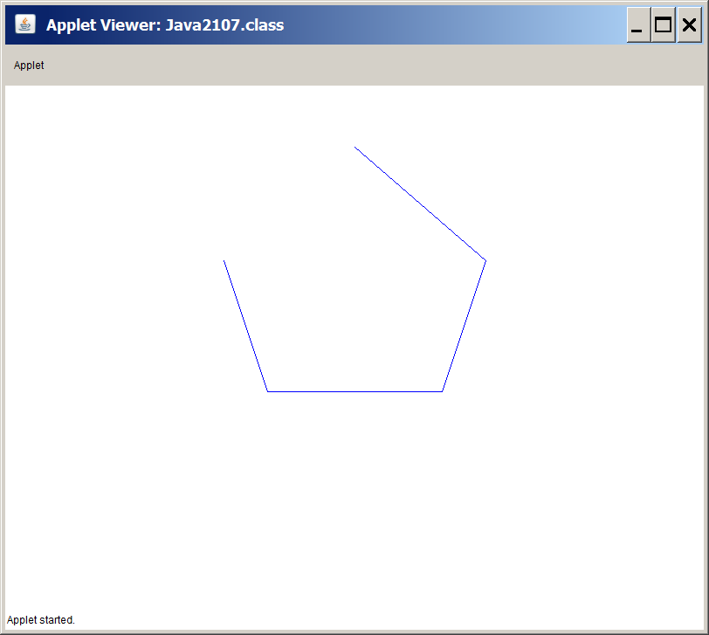
// Java2107.java
// This program draws a sequence
// of connected lines with the
// <drawPolyline> method.
import java.awt.*;
import java.applet.*;
public class Java2107 extends Applet
{
public void paint(Graphics g)
{
g.setColor(Color.blue);
int xCoord[] = {400,550,500,300,250};
int yCoord[] = {70,200,350,350,200};
g.drawPolyline(xCoord,yCoord,5);
}
}

Slide 18
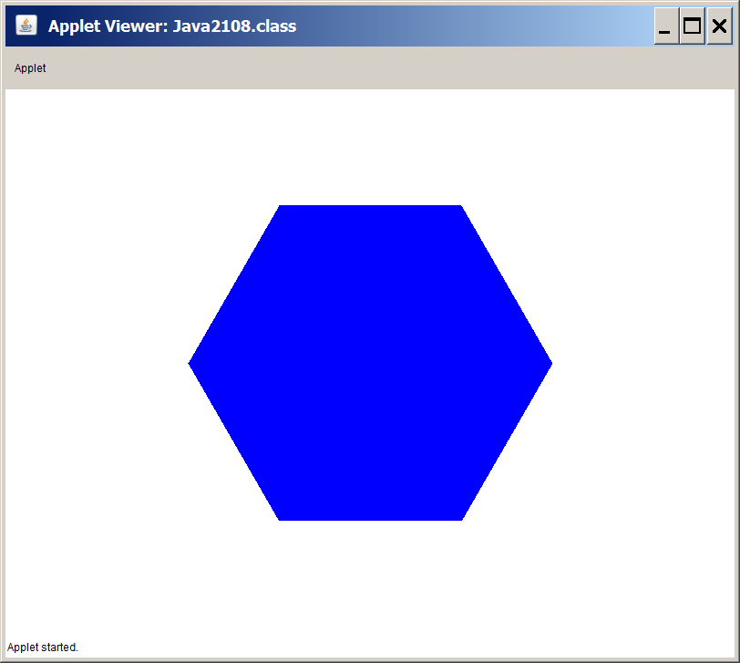
// Java2108.java
// This program demonstrates how to draw a regular hexagon efficiently by using
// coordinates arrays inside a loop control structure.
import java.awt.*;
import java.applet.*;
public class Java2108 extends Applet
{
public void paint(Graphics g)
{
int centerX = 400;
int centerY = 300;
int radius = 200;
double twoPI = 2 * Math.PI;
int xCoord[] = new int[6];
int yCoord[] = new int[6];
g.setColor(Color.blue);
for (int k = 0; k < 6; k++)
{
xCoord[k] = (int) Math.round(Math.cos(twoPI * k/6) * radius) + centerX;
yCoord[k] = (int) Math.round(Math.sin(twoPI * k/6) * radius) + centerY;
}
g.fillPolygon(xCoord,yCoord,6);
}
}

Slide 19
// Java2109.java
// This program uses the regular hexagon code and creates a general regular Polygon method.
import java.awt.*;
import java.applet.*;
public class Java2109 extends Applet
{
public void paint(Graphics g)
{
int sides = 5;
for (int y = 100; y <= 500; y+=120)
{
for (int x = 100; x <= 800; x+=120)
regPolygon(g,50,x,y,sides);
sides++;
}
}
public void regPolygon(Graphics g, int radius, int centerX, int centerY,int sides)
{
double twoPI = 2 * Math.PI;
int xCoord[] = new int[sides];
int yCoord[] = new int[sides];
g.setColor(Color.blue);
for (int k = 0; k < sides; k++)
{
xCoord[k] = (int) Math.round(Math.cos(twoPI * k/sides) * radius) + centerX;
yCoord[k] = (int) Math.round(Math.sin(twoPI * k/sides) * radius) + centerY;
}
g.fillPolygon(xCoord,yCoord,sides);
}
}

Slide 20
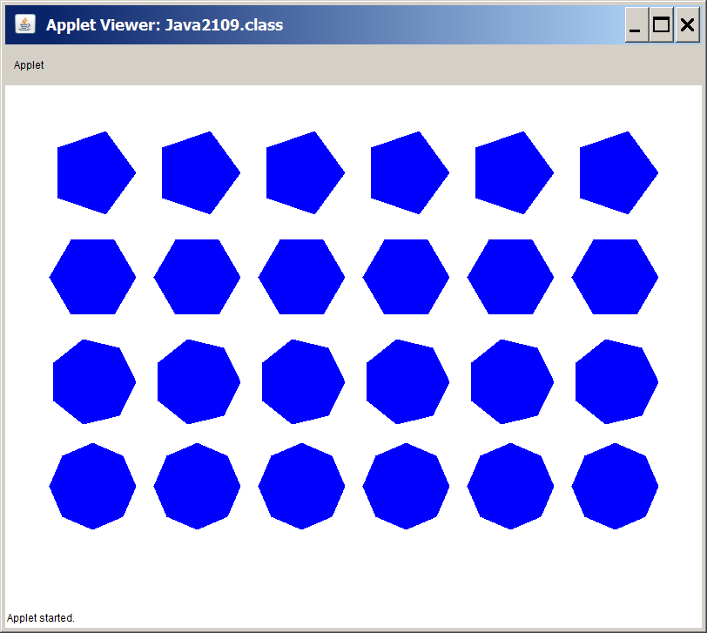

Slide 21
Steps to Turn Off Warning Messages in JCreator
1. Click Configure
2. Click Options
3. Click JDK Tools
4. Select Compiler in the tool type window
5. Click Edit
6. Click Parameters tab
7. Remove check from Warnings check box
8. Click OK twice

Slide 22

Section 21.5
Mouse Routines
with Graphics

Slide 23
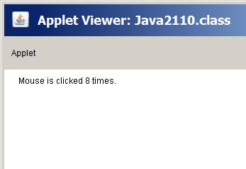
// Java2110.java
// This program counts the number of times a mouse is clicked.
// Both left-clicks and right-clicks are counted using the <mouseDown> event.
// Ignore the "deprecated API" warning.
import java.applet.Applet;
import java.awt.*;
public class Java2110 extends Applet
{
int numClicks;
public void init() { numClicks = 0; }
public void paint(Graphics g)
{
g.drawString("Mouse is clicked " + numClicks + " times.",20,20);
}
public boolean mouseDown(Event e, int x, int y)
{
numClicks++;
repaint();
return true;
}
}

Slide 24
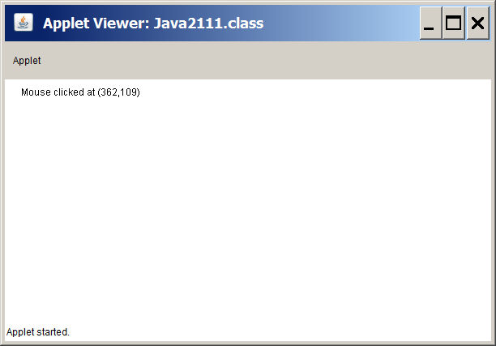
// Java2111.java
// This program displays the position of the mouse every time it is clicked
// using the <mouseDown> method.
import java.applet.Applet;
import java.awt.*;
public class Java2111 extends Applet
{
int xCoord, yCoord;
public void paint(Graphics g)
{
g.drawString("Mouse clicked at (" + xCoord + "," + yCoord + ")",20,20);
}
public boolean mouseDown(Event e, int x, int y)
{
xCoord = x;
yCoord = y;
repaint();
return true;
}
}

Slide 25
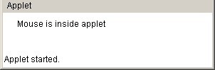
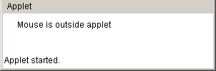
// Java2112.java
// This program demonstrates how to determine if the mouse is inside or
// outside the Applet window using the <mouseEnter> and <mouseExit> methods.
import java.applet.Applet;
import java.awt.*;
public class Java2112 extends Applet
{
boolean insideApplet;
public void paint(Graphics g)
{
if (insideApplet)
g.drawString("Mouse is inside applet",20,20);
else
g.drawString("Mouse is outside applet",20,20);
}
public boolean mouseEnter(Event e, int x, int y)
{
insideApplet = true;
repaint();
return true;
}
public boolean mouseExit(Event e, int x, int y)
{
insideApplet = false;
repaint();
return true;
}
}

Slide 26
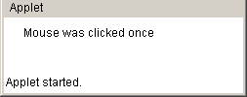
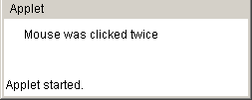
// Java2113.java
// This program determines if a mouse is clicked once or twice using the
// <clickCount> method. This method works for the left or right button.
import java.applet.Applet;
import java.awt.*;
public class Java2113 extends Applet
{
boolean singleClick,doubleClick;
public void paint(Graphics g)
{
if (singleClick)
g.drawString("Mouse was clicked once",20,20);
if (doubleClick)
g.drawString("Mouse was clicked twice",20,20);
}
public boolean mouseDown(Event e, int x, int y)
{
switch (e.clickCount)
{
case 1:
singleClick = true; doubleClick = false;
break;
case 2:
doubleClick = true; singleClick = false;
}
repaint();
return true;
}
}

Slide 27
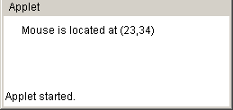

// Java2114.java
// This program displays the position of the mouse every time it moves
// using the <mouseMove> method.
import java.applet.Applet;
import java.awt.*;
public class Java2114 extends Applet
{
int xCoord, yCoord;
public void paint(Graphics g)
{
g.drawString("Mouse is located at (" + xCoord + "," + yCoord + ")",20,20);
}
public boolean mouseMove(Event e, int x, int y)
{
xCoord = x;
yCoord = y;
repaint();
return true;
}
}

Slide 28
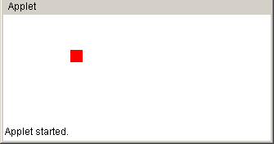
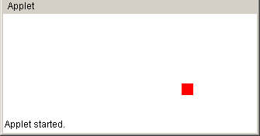
// Java2115.java
// This program draws a small square at every mouse click position.
import java.applet.Applet;
import java.awt.*;
public class Java2115 extends Applet
{
int xCoord; int yCoord;
boolean firstPaint;
public void init() { firstPaint = true; }
public void paint(Graphics g)
{
if (firstPaint)
firstPaint = false;
else
{
g.setColor(Color.red);
g.fillRect(xCoord,yCoord,15,15);
}
}
public boolean mouseDown(Event e, int x, int y)
{
xCoord = x;
yCoord = y;
repaint();
return true;
}
}

Slide 29
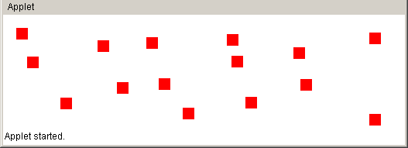
// Java2116.java // This program draws small squares // at every mouse click position. // The program will crash if you try // to draw more than 100 squares. import java.applet.Applet; import java.awt.*; public class Java2116 extends Applet { int xCoord[]; int yCoord[]; int numSquare; boolean firstPaint; public void init() { xCoord = new int[100]; yCoord = new int[100]; numSquare = 0; firstPaint = true; } | public void paint(Graphics g) { g.setColor(Color.red); for (int k = 0; k < numSquare; k++) g.fillRect(xCoord[k],yCoord[k],15,15); } public boolean mouseDown(Event e, int x, int y) { xCoord[numSquare] = x; yCoord[numSquare] = y; numSquare++; repaint(); return true; } }

Slide 30
// Java2117.java // This uses the <Rectangle> class with the // <inside> method to determine if a certain // square has been clicked. import java.applet.Applet; import java.awt.*; public class Java2117 extends Applet { Rectangle red, green, blue; int numColor; public void init() { red = new Rectangle(50,50,100,100); green = new Rectangle(50,200,100,100); blue = new Rectangle(50,350,100,100); numColor = 0; } public boolean mouseDown(Event e, int x, int y) { if(red.inside(x,y)) numColor = 1; else if(green.inside(x,y)) numColor = 2; else if(blue.inside(x,y)) numColor = 3; else numColor = 4; repaint(); return true; } | public void paint(Graphics g) { g.setColor(Color.red); g.fillRect(50,50,100,100); g.setColor(Color.green); g.fillRect(50,200,100,100); g.setColor(Color.blue); g.fillRect(50,350,100,100); switch (numColor) { case 1: g.setColor(Color.red); g.drawString("Mouse clicked inside red", 200,75); break; case 2: g.setColor(Color.green); g.drawString("Mouse clicked inside green", 200,225); break; case 3: g.setColor(Color.blue); g.drawString("Mouse clicked inside blue", 200,375); break; case 4: g.setColor(Color.black); g.drawString( "Mouse is clicked outside the colored squares", 50,20); break; } } }

Slide 31
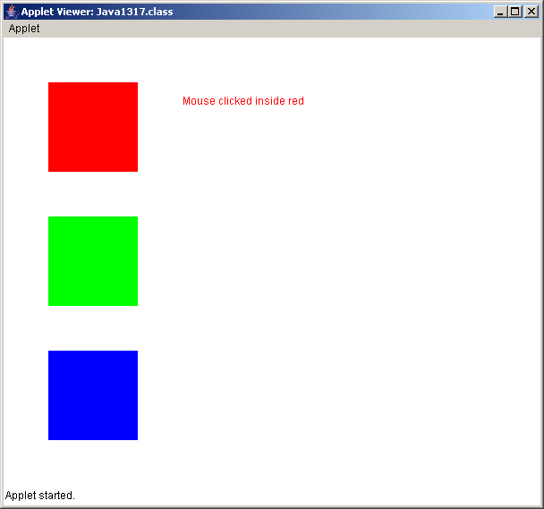



Slide 32
// Java2118.java
// This program proves that objects of the <Rectangle> class are abstract to the viewer and
// not visible. The three square are intentionally not displayed. The program still works
// like the previous program, but you must guess at the location of the squares.
import java.applet.Applet; import java.awt.*; public class Java2118 extends Applet { Rectangle red, green, blue; int numColor; public void init() { red = new Rectangle(50,50,100,100); green = new Rectangle(50,200,100,100); blue = new Rectangle(50,350,100,100); numColor = 0; } public boolean mouseDown(Event e, int x, int y) { if(red.inside(x,y)) numColor = 1; else if(green.inside(x,y)) numColor = 2; else if(blue.inside(x,y)) numColor = 3; else numColor = 4; repaint(); return true; } | public void paint(Graphics g) { switch (numColor) { case 1: g.setColor(Color.red); g.drawString("Mouse clicked inside red", 200,75); break; case 2: g.setColor(Color.green); g.drawString("Mouse clicked inside green", 200,225); break; case 3: g.setColor(Color.blue); g.drawString("Mouse clicked inside blue", 200,375); break; case 4: g.setColor(Color.black); g.drawString( "Mouse is clicked outside the colored squares", 50,20); break; } } }

Slide 33
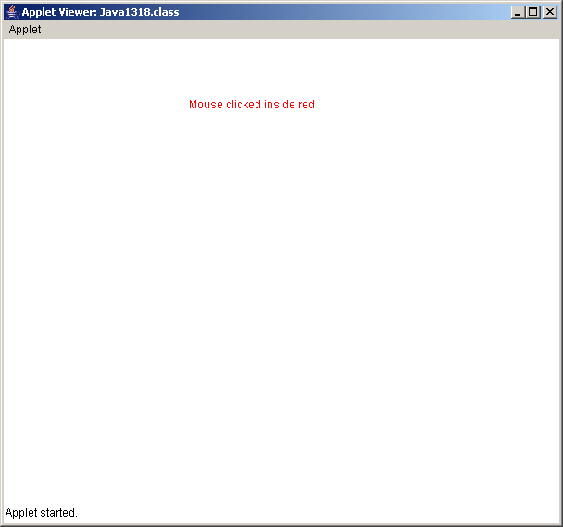
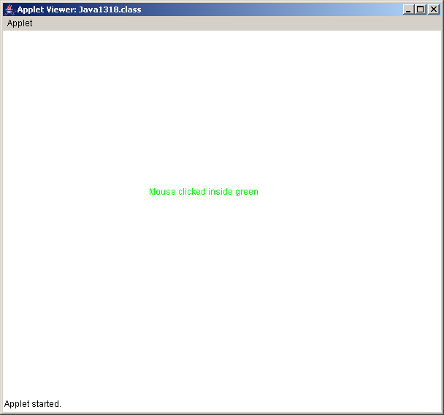
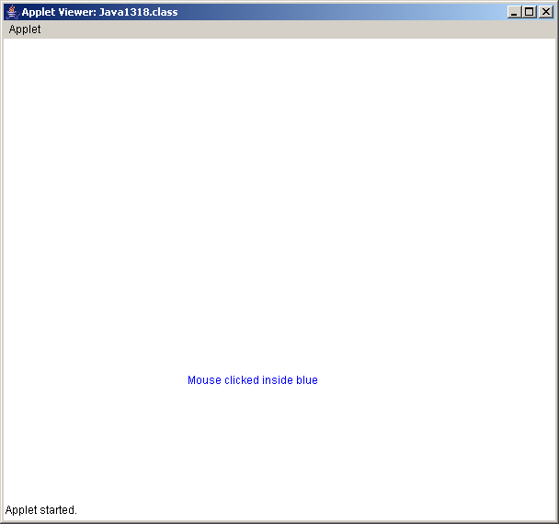

Slide 34
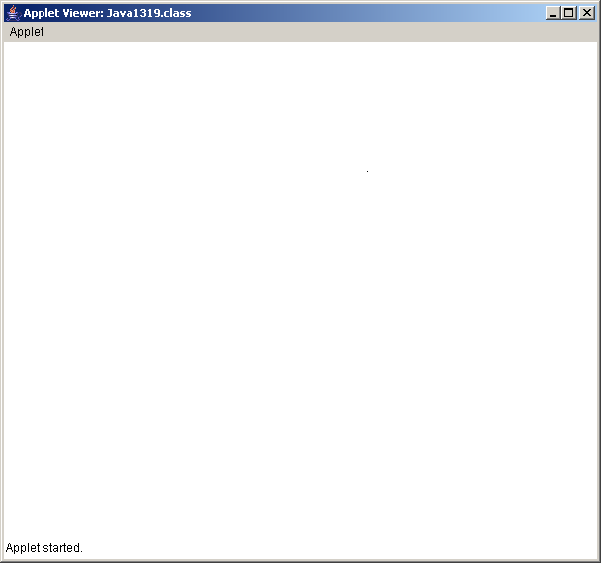
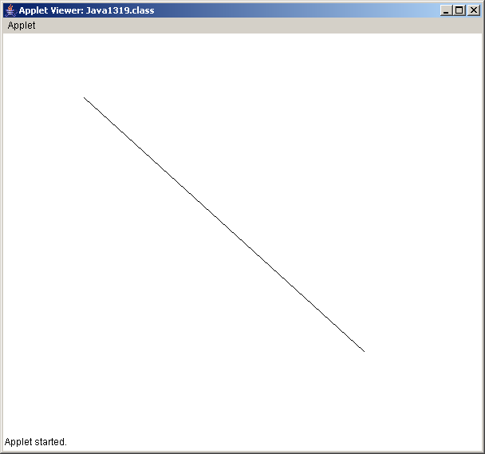
// Java2119.java
// This program draws a straight line from the point where the mouse is clicked
// to the point where the mouse is released.
import java.applet.Applet;
import java.awt.*;
public class Java2119 extends Applet
{
int startX,startY,endX,endY;
public void paint(Graphics g)
{
g.drawLine(startX,startY,endX,endY);
}
public boolean mouseDown(Event e, int x, int y)
{
startX = x;
startY = y;
return true;
}
public boolean mouseUp(Event e, int x, int y)
{
endX = x;
endY = y;
repaint();
return true;
}
}

Slide 35
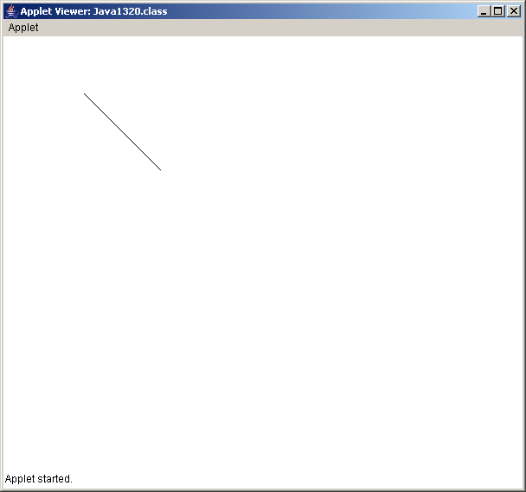
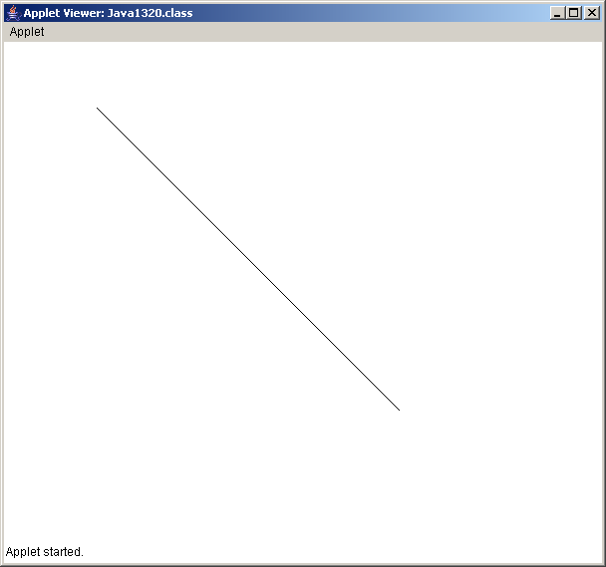
// Java2120.java
// This program draws a straight line from the point where the mouse is clicked
// to the point where the mouse is released. In this example the line is constantly visible.
import java.applet.Applet;
import java.awt.*;
public class Java2120 extends Applet
{
int startX,startY,endX,endY;
public void paint(Graphics g)
{
g.drawLine(startX,startY,endX,endY);
}
public boolean mouseDown(Event e, int x, int y)
{
startX = x;
startY = y;
return true;
}
public boolean mouseDrag(Event e, int x, int y)
{
endX = x;
endY = y;
repaint();
return true;
}
}

Slide 36
// Java2121.java // This program draws a straight line // from the point where the mouse is // clicked to the point where the // mouse is released. Additionally, // the program stores the lines // coordinate information in arrays // so that all the lines are visible. import java.applet.Applet; import java.awt.*; public class Java2121 extends Applet { int[] startX,startY,endX,endY; int currentStartX,currentStartY; int currentEndX,currentEndY; boolean currentLineDone; int lineCount; public void init() { startX = new int[100]; startY = new int[100]; endX = new int[100]; endY = new int[100]; lineCount = 0; currentLineDone = false; } | public void paint(Graphics g) { for (int k = 0; k < lineCount; k++) g.drawLine(startX[k],startY[k],endX[k],endY[k]); if (!currentLineDone) g.drawLine(currentStartX,currentStartY,currentEndX,currentEndY); currentLineDone = false; } public boolean mouseDown(Event e, int x, int y) { currentStartX = x; currentStartY = y; return true; } public boolean mouseDrag(Event e, int x, int y) { currentEndX = x; currentEndY = y; repaint(); return true; } public boolean mouseUp(Event e, int x, int y) { addLine(x,y); currentLineDone = true; return true; } public void addLine(int x, int y) { startX[lineCount] = currentStartX; startY[lineCount] = currentStartY; endX[lineCount] = x; endY[lineCount] = y; lineCount++; repaint(); } }

Slide 37
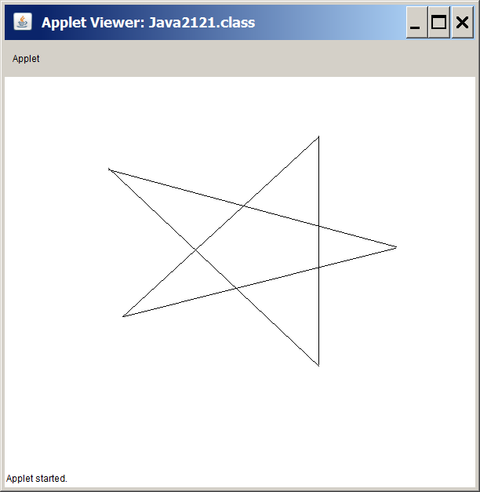

Slide 38
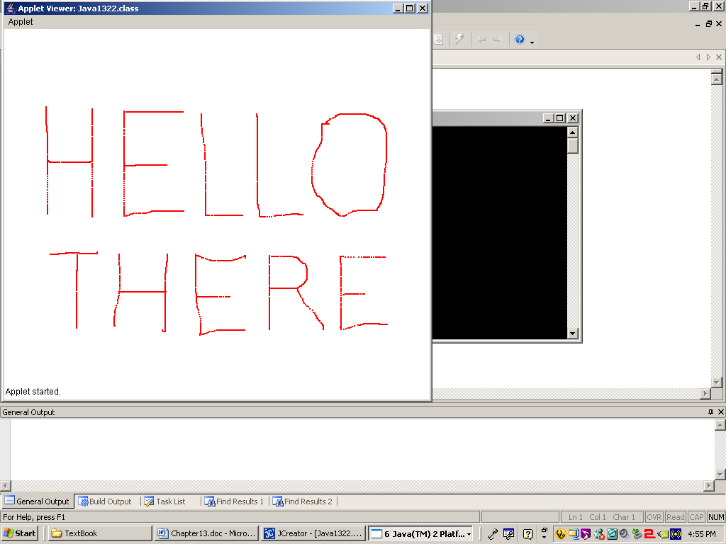
// Java2122.java // This program demonstrates a simple // mouse draw approach. import java.applet.Applet; import java.awt.*; public class Java2122 extends Applet { int[] xCoord,yCoord; int pointCount; public void init() { xCoord = new int[10000]; yCoord = new int[10000]; pointCount = 0; } public void paint(Graphics g) { g.setColor(Color.red); for (int k = 0; k < pointCount; k++) g.fillRect(xCoord[k],yCoord[k],2,2); } | public boolean mouseDrag(Event e, int x, int y) { xCoord[pointCount] = x; yCoord[pointCount] = y; pointCount++; repaint(); return true; } }

Slide 39
Section 21.6
Understanding
Graphics Displays

Slide 40
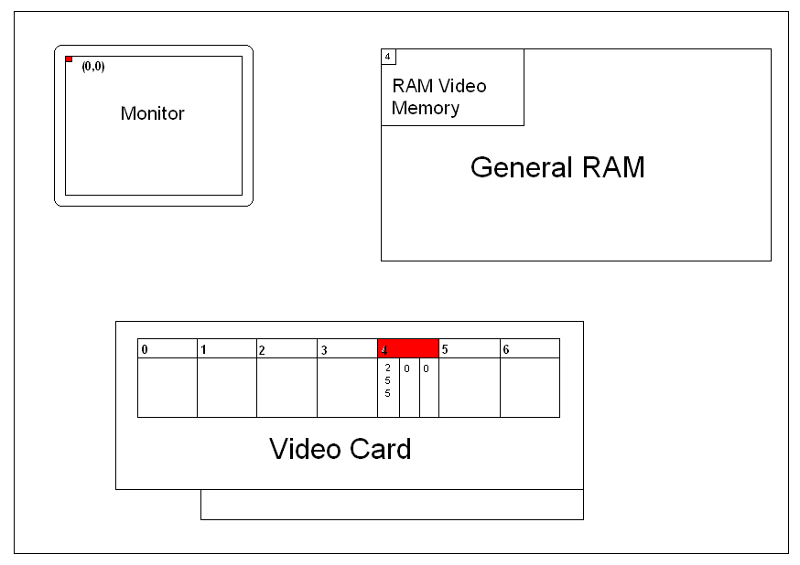
Understanding Graphics Displays
Imagine that the video card has a bunch of color code boxes.
Box code number 4 contains the RGB value of (255,0,0) which is bright red.
This gives us the following sequence of operations:
▪ Some method call places the color code 4 in the video memory.
▪ The video card identifies that code 4 is bright red.
▪ A bright-red pixel is now displayed on the monitor at coordinate (0,0).

Slide 41
Section 21.7
Virtual Memory
& Video Buffering

Slide 42
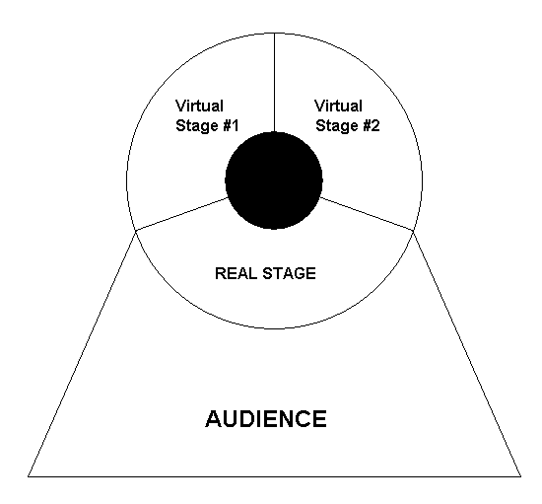
Virtual Memory
&
Video Buffering

Slide 43
Section 21.8
Buffering
Program Examples

Slide 44
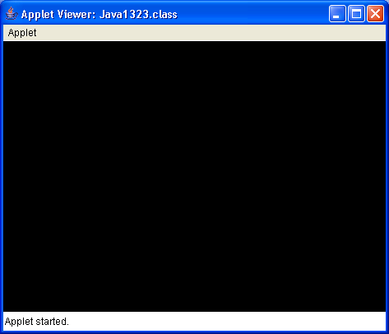
// Java2123.java
// This program creates an applet window with a black background.
import java.awt.*;
import java.applet.Applet;
public class Java2123 extends Applet
{
int appletWidth; // width of the Applet window
int appletHeight; // height of the Applet window
public void init()
{
appletWidth = getWidth();
appletHeight = getHeight();
}
public void paint(Graphics g)
{
g.setColor(Color.BLACK);
g.fillRect(0,0,appletWidth,appletHeight);
}
}

Slide 45
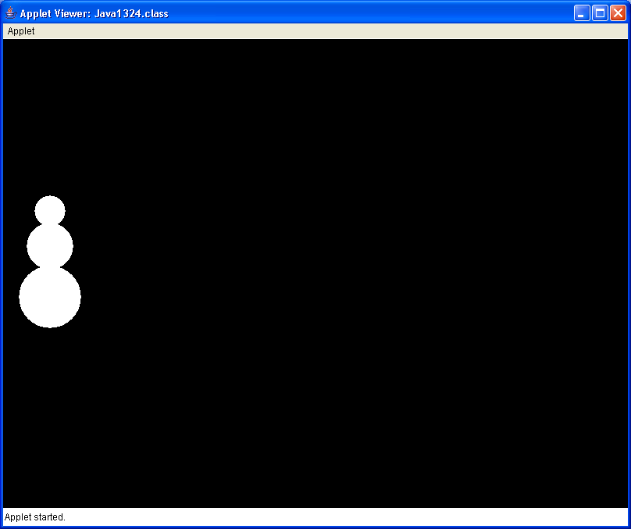
// Java2124.java This program introduces the <drawSnowman> method.
import java.awt.*;
import java.applet.*;
public class Java2124 extends Applet
{
int appletWidth; // width of the Applet window
int appletHeight; // height of the Applet window
public void init()
{
appletWidth = getWidth();
appletHeight = getHeight();
}
public void paint(Graphics g)
{
g.setColor(Color.BLACK);
g.fillRect(0,0,appletWidth,appletHeight);
drawSnowman(g,20,200);
}
public void drawSnowman(Graphics g, int x, int y)
{
g.setColor(Color.WHITE);
g.fillOval(x+20,y,40,40);
g.fillOval(x+10,y+35,60,60);
g.fillOval(x,y+90,80,80);
}
}

Slide 46
// Java2125.java
// This program adds the <eraseSnowman> method to the <drawSnowman> method.
// The snowman is not visible because it is erased as quickly as it is drawn.
import java.awt.*; import java.applet.*; public class Java2125 extends Applet { int appletWidth; // width of the Applet window int appletHeight; // height of the Applet window public void init() { appletWidth = getWidth(); appletHeight = getHeight(); } public void paint(Graphics g) { g.setColor(Color.BLACK); g.fillRect(0,0,appletWidth,appletHeight); for (int x = 20; x < 700; x += 100) { drawSnowman(g,x,200); eraseSnowman(g,x,200); } } | public void drawSnowman(Graphics g, int x, int y) { g.setColor(Color.WHITE); g.fillOval(x+20,y,40,40); g.fillOval(x+10,y+35,60,60); g.fillOval(x,y+90,80,80); } public void eraseSnowman(Graphics g, int x, int y) { g.setColor(Color.BLACK); g.fillRect(x,y,80,170); } }

Slide 47
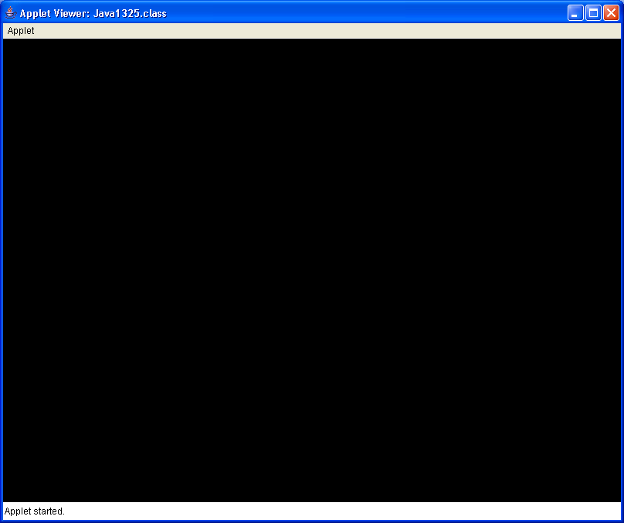
The output is not visible
since the snowman moves
across the screen so fast.

Slide 48
Important Note
The next few programming examples demonstrate computer animation.
While an attempt will be made to duplicate the animation affects with PowerPoint, you need to compile and execute the programs for yourself to truly see the program output.

Slide 49
// Java2126.java
// This program adds a <delay> method, which makes it possible to see the snowman movement.
import java.awt.*; import java.applet.*; public class Java2126 extends Applet { int appletWidth; // width of Applet window int appletHeight;// height of Applet window public void init() { appletWidth = getWidth(); appletHeight = getHeight(); } public void paint(Graphics g) { g.setColor(Color.BLACK); g.fillRect(0,0,appletWidth,appletHeight); for (int x = 20; x < 700; x += 10) { drawSnowman(g,x,200); delay(50); eraseSnowman(g,x,200); } } | public void drawSnowman(Graphics g, int x, int y) { g.setColor(Color.WHITE); g.fillOval(x+20,y,40,40); g.fillOval(x+10,y+35,60,60); g.fillOval(x,y+90,80,80); } public void eraseSnowman(Graphics g, int x, int y) { g.setColor(Color.BLACK); g.fillRect(x,y,80,170); } public void delay(int n) { long startDelay = System.currentTimeMillis(); long endDelay = 0; while (endDelay - startDelay < n) endDelay = System.currentTimeMillis(); } }

Slide 50
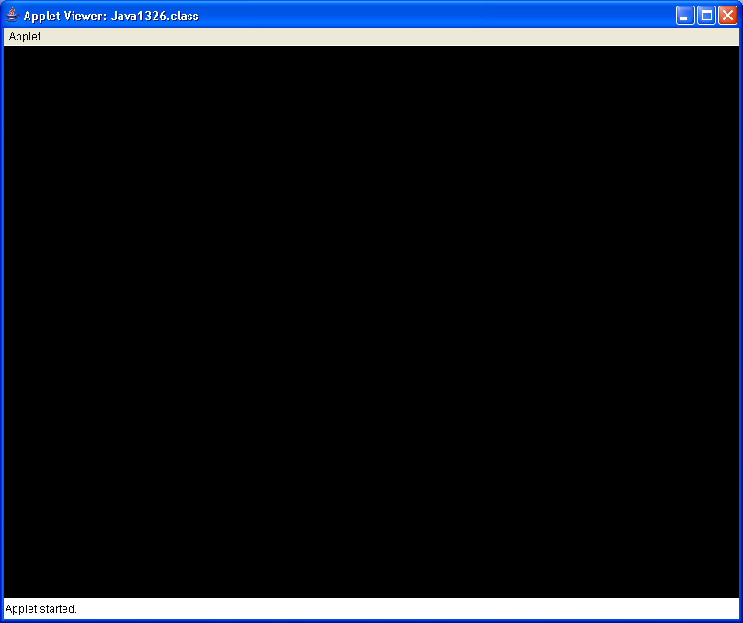
Simulated Output

Slide 51
// Java2127.java
// This program demonstrates that the "draw and erase" animation approach
// does not work on a multi-colored background.
import java.awt.*; import java.applet.*; import java.util.*; public class Java2127 extends Applet { int appletWidth; // width of Applet window int appletHeight; // height of Applet window public void init() { appletWidth = getWidth(); appletHeight = getHeight(); } public void paint(Graphics g) { g.setColor(Color.BLACK); createBackGround(g); for (int x = 20; x < 700; x += 10) { drawSnowman(g,x,200); delay(50); eraseSnowman(g,x,200); } } | public void createBackGround(Graphics g) { Random rnd = new Random(12345); for (int k = 1; k <= 1000; k++) { int rndX = rnd.nextInt(750); int rndY = rnd.nextInt(550); g.setColor(new Color(rnd.nextInt(256), rnd.nextInt(256),rnd.nextInt(256))); g.fillRect(rndX,rndY,50,50); } } // These 3 methods are the same as before public void drawSnowman(Graphics g, int x, int y) public void eraseSnowman(Graphics g, int x, int y) public void delay(int n) }

Slide 52
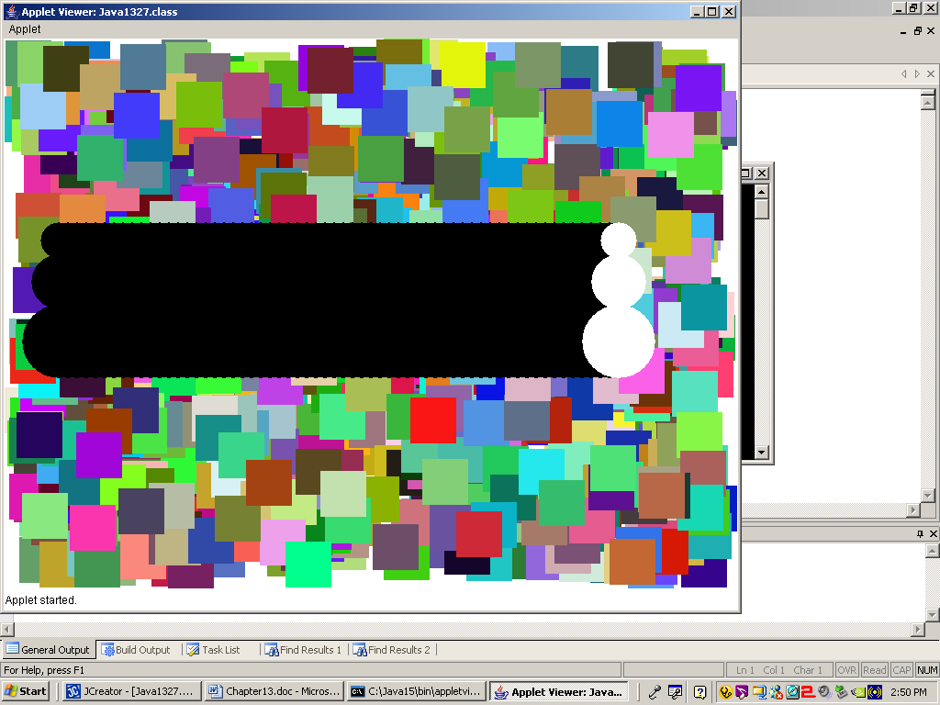

Slide 53
// Java2128.java
// This program cures the animation problem with virtual memory, buffer methods.
import java.awt.*; import java.applet.*; import java.util.*; public class Java2128 extends Applet { int appletWidth; // width of Applet window int appletHeight; // height of Applet window Image virtualMem; Graphics gBuffer; public void init() { appletWidth = getWidth(); appletHeight = getHeight(); virtualMem = createImage(appletWidth, appletHeight); gBuffer = virtualMem.getGraphics(); } public void paint(Graphics g) { for (int x = 20; x < 700; x += 5) { drawSnowman(g,x,200); delay(10); } } | public void drawSnowman(Graphics g, int x, int y) { createBackGround(); gBuffer.setColor(Color.WHITE); gBuffer.fillOval(x+20,y,40,40); gBuffer.fillOval(x+10,y+35,60,60); gBuffer.fillOval(x,y+90,80,80); g.drawImage (virtualMem,0,0, this); } public void createBackGround() { Random rnd = new Random(12345); for (int k = 1; k <= 1000; k++) { int rndX = rnd.nextInt(750); int rndY = rnd.nextInt(550); gBuffer.setColor(new Color(rnd.nextInt(256), rnd.nextInt(256),rnd.nextInt(256))); gBuffer.fillRect(rndX,rndY,50,50); } } public void delay(int n) // same as before }

Slide 54
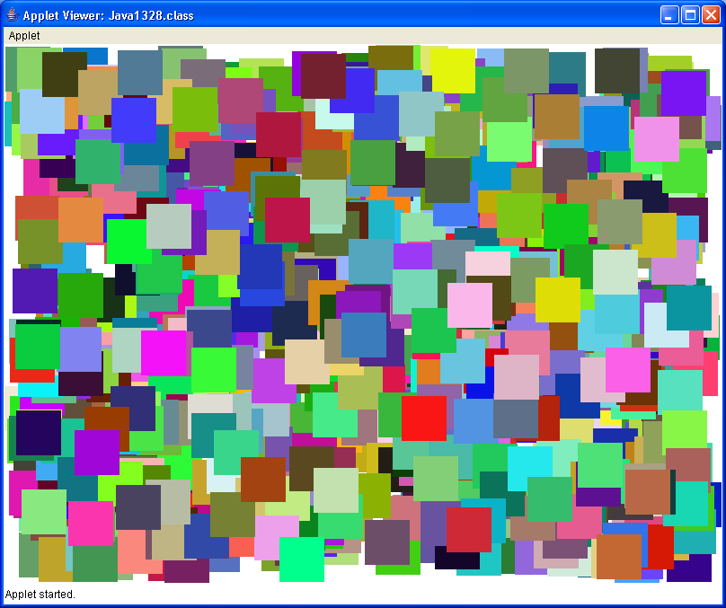
Simulated Output

Slide 55
// Java2129.java
// This program uses virtual memory for a simple draw program.
// The program will flicker while drawing.
import java.applet.Applet; import java.awt.*; public class Java2129 extends Applet { Image virtualMem; Graphics gBuffer; int oldX, oldY, newX, newY; int appletWidth, appletHeight; public void init() { appletWidth = getWidth(); appletHeight = getHeight(); virtualMem = createImage(appletWidth,appletHeight); gBuffer = virtualMem.getGraphics(); gBuffer.setColor(Color.white); gBuffer.fillRect(0,0,appletWidth,appletHeight); } public void paint(Graphics g) { gBuffer.setColor(Color.black); gBuffer.drawString("Move inside the applet to draw", 20,20); gBuffer.setColor(Color.blue); gBuffer.fillRect(oldX,oldY,2,2); g.drawImage(virtualMem,0,0,this); } | public boolean mouseDown( Event e, int x, int y) { newX = x; newY = y; oldX = newX; oldY = newY; repaint(); return true; } public boolean mouseDrag( Event e, int x, int y) { newX = x; newY = y; oldX = newX; oldY = newY; repaint(); return true; } }

Slide 56
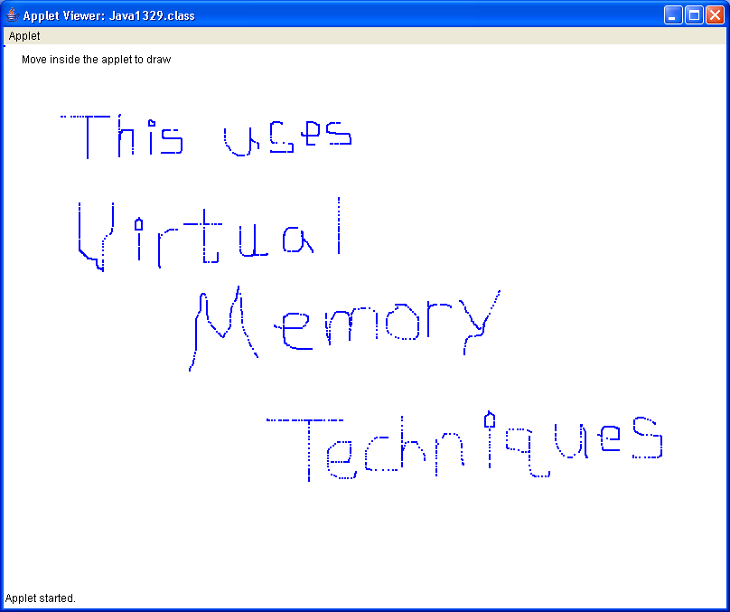

Slide 57
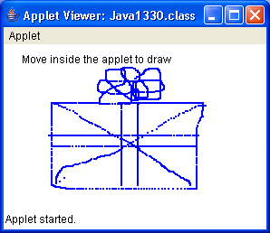
// Java2130.java
// This program adds the <update> methods which stabilizes the flicker of the
// Java2122.java and Java2129.java programs.
import java.applet.Applet; import java.awt.*; public class Java2130 extends Applet { Image virtualMem; Graphics gBuffer; int oldX, oldY, newX, newY; int appletWidth, appletHeight; public void init() { appletWidth = getWidth(); appletHeight = getHeight(); virtualMem = createImage(appletWidth,appletHeight); gBuffer = virtualMem.getGraphics(); gBuffer.setColor(Color.white); gBuffer.fillRect(0,0,appletWidth,appletHeight); } public void paint(Graphics g) { gBuffer.setColor(Color.black); gBuffer.drawString("Move inside the applet to draw", 20,20); gBuffer.setColor(Color.blue); gBuffer.fillRect(oldX,oldY,2,2); g.drawImage(virtualMem,0,0,this); } | // These 2 methods // are the same as before public boolean mouseDown( Event e, int x, int y) public boolean mouseDrag( Event e, int x, int y) public void update( Graphics g) { paint(g); }

Slide 58
Section 21.9
The Magic of
Method update

Slide 59
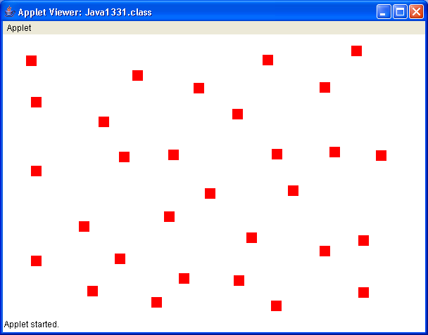
// Java2131.java
// This program draws small squares using the <update> method rather than
// using arrays to store coordinate values.
import java.applet.Applet; import java.awt.*; public class Java2131 extends Applet { int xCoord; int yCoord; boolean firstPaint; public void init() { firstPaint = true; } public void paint(Graphics g) { if (firstPaint) firstPaint = false; else { g.setColor(Color.red); g.fillRect(xCoord,yCoord,15,15); } } | public boolean mouseDown(Event e, int x, int y) { xCoord = x; yCoord = y; repaint(); return true; } public void update(Graphics g) { paint(g); } }

Slide 60
// Java2132.java
// This program revisits the earlier Java2120.java program using the <update> method.
// It shows that <update> can cause an unwanted side effect.
import java.applet.Applet; import java.awt.*; public class Java2132 extends Applet { int startX,startY,endX,endY; public void paint(Graphics g) { g.drawLine(startX,startY,endX,endY); } public void update(Graphics g) { paint(g); } | public boolean mouseDown(Event e, int x, int y) { startX = x; startY = y; return true; } public boolean mouseDrag(Event e, int x, int y) { endX = x; endY = y; repaint(); return true; } }

Slide 61
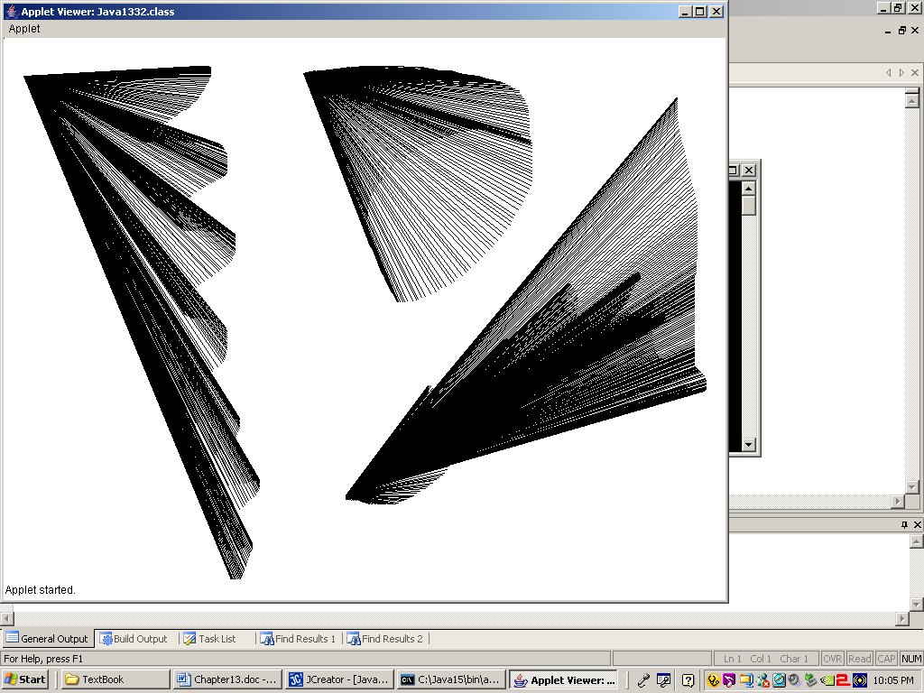

Slide 62
Section 21.10
Importing
Images

Slide 63
// Java2133.java
// This program demonstrates how to display a graphics image from a gif file
// at any x,y location on the screen.
import java.awt.*;
public class Java2133 extends java.applet.Applet
{
Image picture;
public void init()
{
picture = getImage(getDocumentBase(),"LSchram.gif");
}
public void paint(Graphics g)
{
g.drawImage(picture,0,0,this);
g.drawImage(picture,600,150,this);
g.drawImage(picture,300,400,this);
}
}

Slide 64
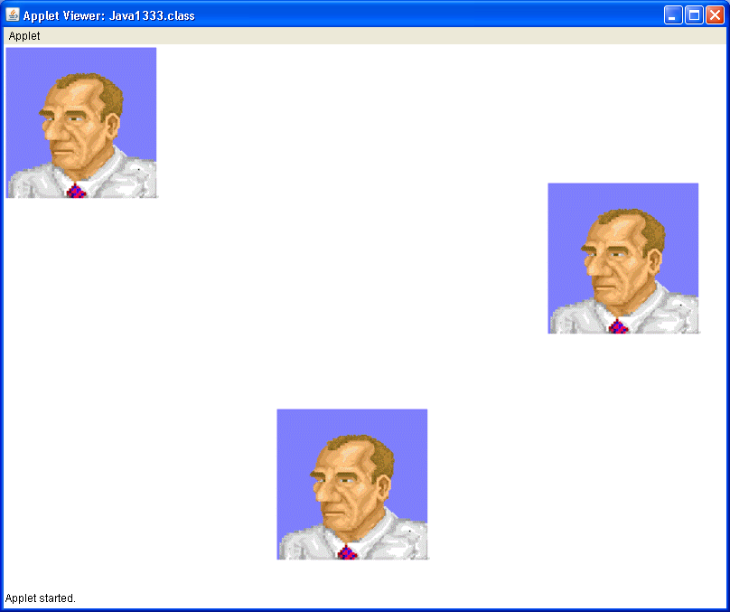
0,0
600,150
300,400

Slide 65
// Java2134.java
// This program demonstrates displaying different images of different types.
// It also shows that gif, jpg and png files can be displayed.
// The bmp file will not display.
public class Java2134 extends java.applet.Applet
{
Image picture1, picture2, picture3, picture4;
public void init()
{
picture1 = getImage(getDocumentBase(),"LSchram.gif");
picture2 = getImage(getDocumentBase(),"JSchram.jpg");
picture3 = getImage(getDocumentBase(),"ShortCircuit.bmp");
picture4 = getImage(getDocumentBase(),"bunny.png");
}
public void paint(Graphics g)
{
g.drawImage(picture1,0,0,this);
g.drawImage(picture2,300,0,this);
g.drawImage(picture3,50,300,this);
g.drawImage(picture4,400,400,this);
}
}

Slide 66
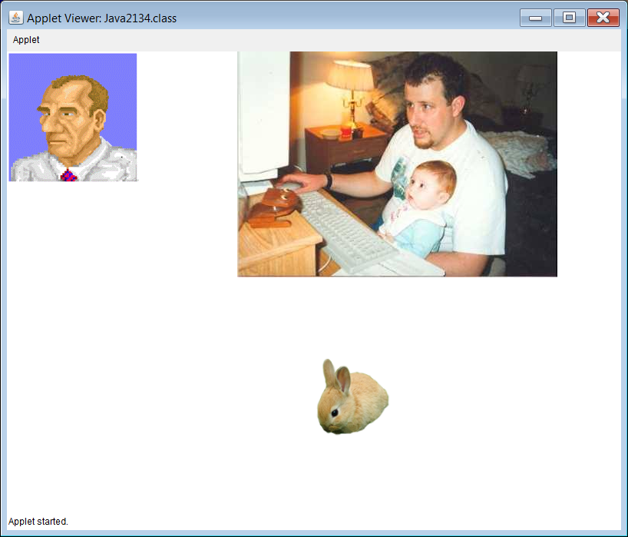

Slide 67

This is the
bmp image
that was
NOT displayed.

Slide 68
// Java2135.java
// This program demonstrates that animated gifs are inserted in the same way as
// normals gifs. Animated gifs can cause a flickering side-effect on the screen.
import java.awt.*;
public class Java2135 extends java.applet.Applet
{
Image picture1, picture2, picture3, picture4, picture5, picture6;
public void init()
{
picture1 = getImage(getDocumentBase(),"space.gif");
picture2 = getImage(getDocumentBase(),"computer.gif");
picture3 = getImage(getDocumentBase(),"gears.gif");
picture4 = getImage(getDocumentBase(),"butterfly.gif");
picture5 = getImage(getDocumentBase(),"pizza.gif");
picture6 = getImage(getDocumentBase(),"jet.gif");
}
public void paint(Graphics g)
{
g.drawImage(picture1,100,100,this);
g.drawImage(picture2,450,100,this);
g.drawImage(picture3,700,100,this);
g.drawImage(picture4,100,400,this);
g.drawImage(picture5,400,350,this);
g.drawImage(picture6,700,400,this);
}
}

Slide 69
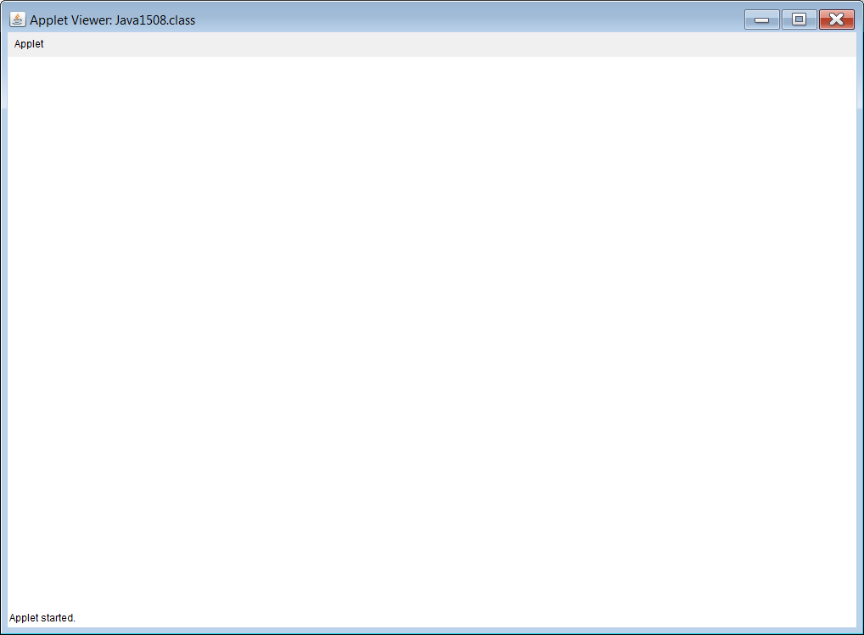
Simulated
Output

Slide 70
// Java2136.java
// This program attempts to cure the flickering caused by the animated gifs by using the update method
// The output shows that for some animated gifs this will work, and for others it will make things worse.
// NOTE: Do not expect to get any "animation bonus points" for using ANIMATED gifs in any
// graphics project. You will lose points instead!
public class Java2136 extends java.applet.Applet
{
Image picture1, picture2, picture3, picture4, picture5, picture6;
public void init()
{
picture1 = getImage(getDocumentBase(),"space.gif");
picture2 = getImage(getDocumentBase(),"computer.gif");
picture3 = getImage(getDocumentBase(),"gears.gif");
picture4 = getImage(getDocumentBase(),"butterfly.gif");
picture5 = getImage(getDocumentBase(),"pizza.gif");
picture6 = getImage(getDocumentBase(),"jet.gif");
}
public void paint(Graphics g)
{
g.drawImage(picture1,100,100,this); g.drawImage(picture2,450,100,this);
g.drawImage(picture3,700,100,this); g.drawImage(picture4,100,400,this);
g.drawImage(picture5,400,350,this); g.drawImage(picture6,700,400,this);
}
public void update(Graphics g) { paint(g); }
}
Check the output
on your computer

Slide 71
Animated Gif WARNING!
Do not insult your teacher's intelligence by trying to pass off an animated gif as an animated graphics project!
Your teacher will be neither impressed, nor amused and this will be demonstrated in your grade.

Slide 72
Section 21.11
Multi-Page
Output

Slide 73
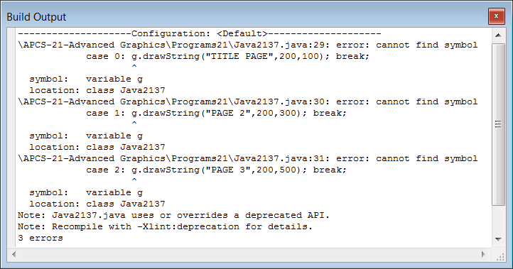
// Java2137.java
// This program attempts to display multiple pages of graphics output.
// The program does not compile because there is no access to the graphics object g.
import java.awt.*;
public class Java2137 extends java.applet.Applet
{
int numClicks;
public void init() { numClicks = 0; }
public void paint(Graphics g)
{
}
public boolean mouseDown(Event e, int x, int y)
{
numClicks++;
switch (numClicks)
{
case 0 : g.drawString("TITLE PAGE",200,100); break;
case 1 : g.drawString("PAGE 2",200,300); break;
case 2 : g.drawString("PAGE 3",200,500); break;
}
repaint();
return true;
}
}

Slide 74
// Java2138.java
// This program attempts to display multiple pages of graphics output.
// While adding the "Graphics g" in the mouseDown parameter list allows
// the program to compile, it also makes it no longer the mouseDown EVENT.
// Now you have a mouseDown METHOD that has no way of being called.
import java.awt.*;
public class Java2138 extends java.applet.Applet
{
int numClicks;
public void init() { numClicks = 0; }
public void paint(Graphics g)
{
}
public boolean mouseDown(Event e, int x, int y, Graphics g)
{
numClicks++;
switch (numClicks)
{
case 0 : g.drawString("TITLE PAGE",200,100); break;
case 1 : g.drawString("PAGE 2",200,300); break;
case 2 : g.drawString("PAGE 3",200,500); break;
}
repaint();
return true;
}
}
No Output

Slide 75
// Java2139.java
// This program shows the correct way to display multiple pages of graphics output.
// Remember... graphics commands CANNOT be executed by EVENTS.
// They can only be executed by the paint method, or by methods called from the paint method.
// Events are used to manipulate the values of variables used by the paint method.
import java.awt.*;
public class Java2139 extends java.applet.Applet
{
int numClicks;
public void init() { numClicks = 0; }
public void paint(Graphics g)
{
switch (numClicks)
{
case 0: page1(g); break;
case 1: page2(g); break;
case 2: page3(g); break;
}
}
public boolean mouseDown(Event e, int x, int y)
{
numClicks++;
repaint();
return true;
}

Slide 76
public void page1(Graphics g)
{
g.setFont(new Font("Arial",Font.BOLD,100));
g.drawString("TITLE PAGE",200,100);
g.setColor(Color.red);
g.fillRect(300,300,200,200);
g.setFont(new Font("Times Roman",Font.PLAIN,20));
g.drawString("Click once to continue",100,500);
}
public void page2(Graphics g)
{
g.setFont(new Font("Arial",Font.BOLD,100));
g.drawString("PAGE 2",200,300);
g.setColor(Color.blue);
g.fillRect(0,0,100,100);
g.setFont(new Font("Times Roman",Font.PLAIN,20));
g.drawString("Click once to continue",100,500);
}
public void page3(Graphics g)
{
g.setColor(Color.green);
g.fillRect(100,100,300,300);
g.setFont(new Font("Arial",Font.BOLD,100));
g.drawString("PAGE 3",200,500);
g.setFont(new Font("Times Roman",Font.PLAIN,20));
g.drawString("Click to exit",400,600);
}
}

Slide 77
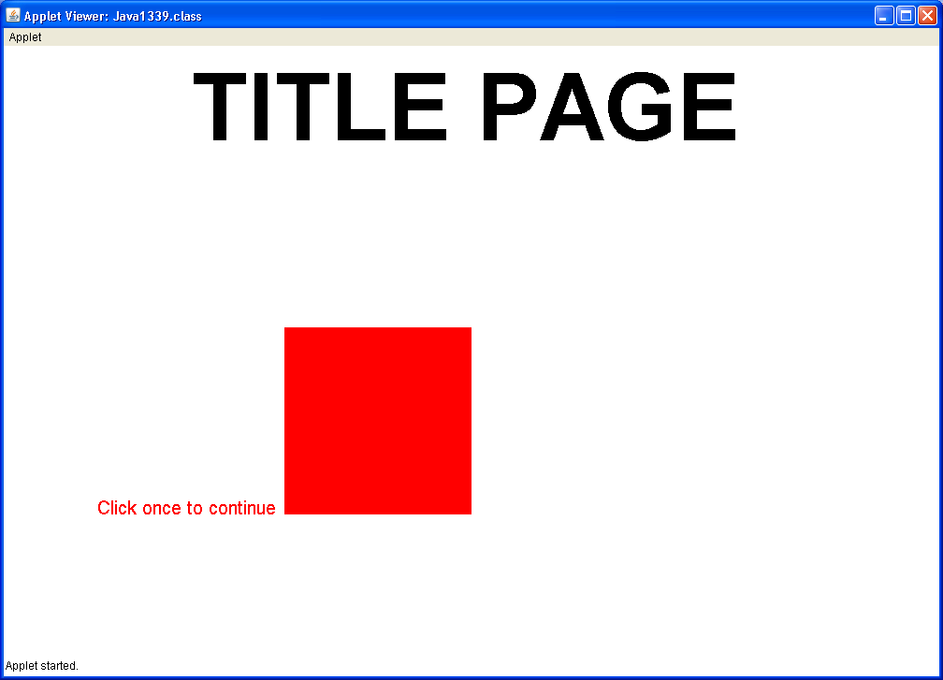

Slide 78
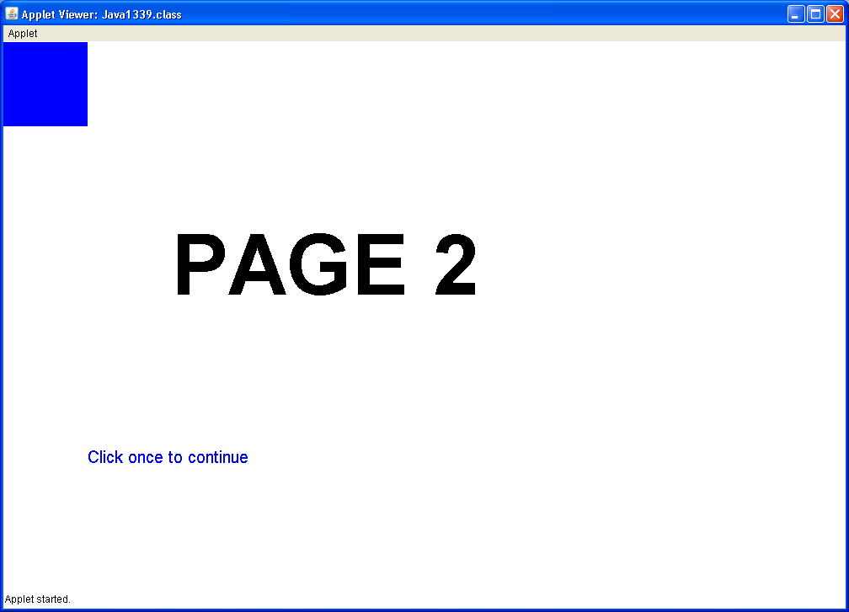

Slide 79
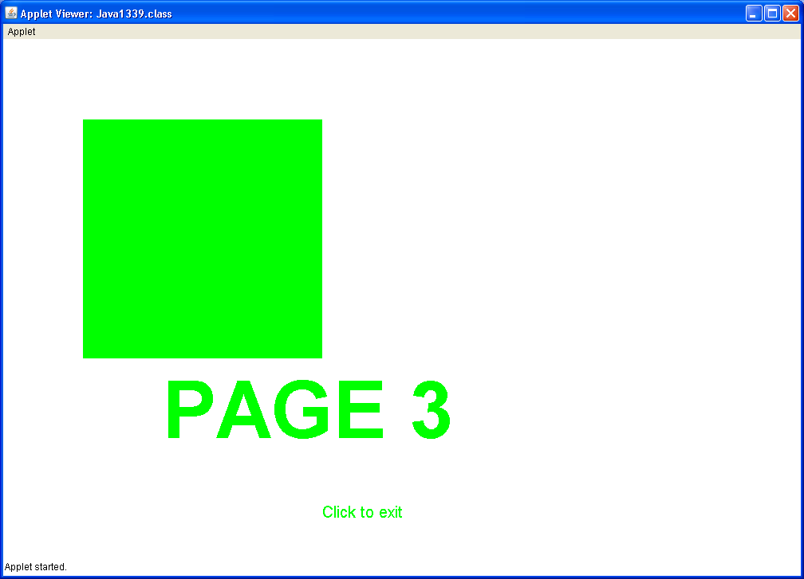

Slide 80
Section 21.12
Program Input
with GUI Windows

Slide 81
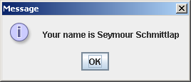
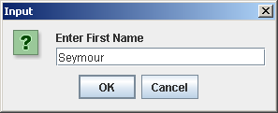

// Java2140.java
// This program introduces GUI program input/output using Swing dialog boxes.
import javax.swing.JOptionPane;
public class Java2140
{
public static void main (String args[])
{
String firstName = JOptionPane.showInputDialog("Enter First Name");
String lastName = JOptionPane.showInputDialog("Enter Last Name");
String fullName = firstName + " " + lastName;
JOptionPane.showMessageDialog(null,"Your name is " + fullName);
System.exit(0);
}
}

Slide 82



// Java2141.java
// This program shows that numerical program input with dialog boxes requires
// a conversion process.
import javax.swing.JOptionPane;
public class Java2141
{
public static void main (String args[])
{
String strNbr1 = JOptionPane.showInputDialog("Enter Number 1");
String strNbr2 = JOptionPane.showInputDialog("Enter Number 2");
int intNbr1 = Integer.parseInt(strNbr1);
int intNbr2 = Integer.parseInt(strNbr2);
int sum = intNbr1 + intNbr2;
JOptionPane.showMessageDialog(null,intNbr1 + " + " + intNbr2 + " = " + sum);
System.exit(0);
}
}

Slide 83


// Java2142.java
// This program demonstrates how to use the <init> method for GUI input
// followed by the <paint> method for graphical output.
import javax.swing.*;
import java.awt.*;
import java.util.*;
public class Java2142 extends JApplet
{
int size; // size of squares to be displayed
int count; // the quantity of squares to be displayed
public void init()
{
String str1 = JOptionPane.showInputDialog("Enter Square Size");
String str2 = JOptionPane.showInputDialog("Enter Square Count");
size = Integer.parseInt(str1);
count = Integer.parseInt(str2);
}
public void paint(Graphics g)
{
Random rnd = new Random(12345);
for (int k = 1; k <= count; k++) {
int x = rnd.nextInt(800-size);
int y = rnd.nextInt(600-size);
int red = rnd.nextInt(256);
int green = rnd.nextInt(256);
int blue = rnd.nextInt(256);
g.setColor(new Color(red,green,blue));
g.fillRect(x,y,size,size);
}
}
}
Remaining output
on the next slide.

Slide 84

Run the program again,
and enter different values!

